Slide 1





Verifiable by Design: Aligning Language Models to Quote from Pre-Training Data
Jingyu (Jack) Zhang
Marc Marone
Tianjian Li
Benjamin Van Durme*
Daniel Khashabi*
*Equal Advising

Slide 2
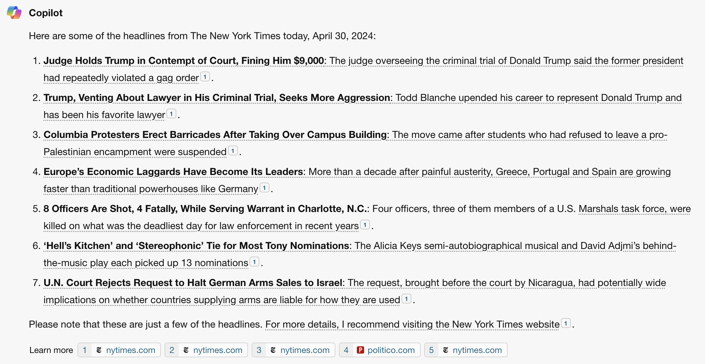
LLMs are powerful
, but not always reliable
Known to produce seemingly plausible but erroneous outputs, aka hallucination
🧐
User: is this hallucination???
Notes:
- start with hallucination
- so user will need to verify the response against trusted responses
- how can user verify? (1) by themselves (2) citation
– we propose the quoting interface

Slide 3
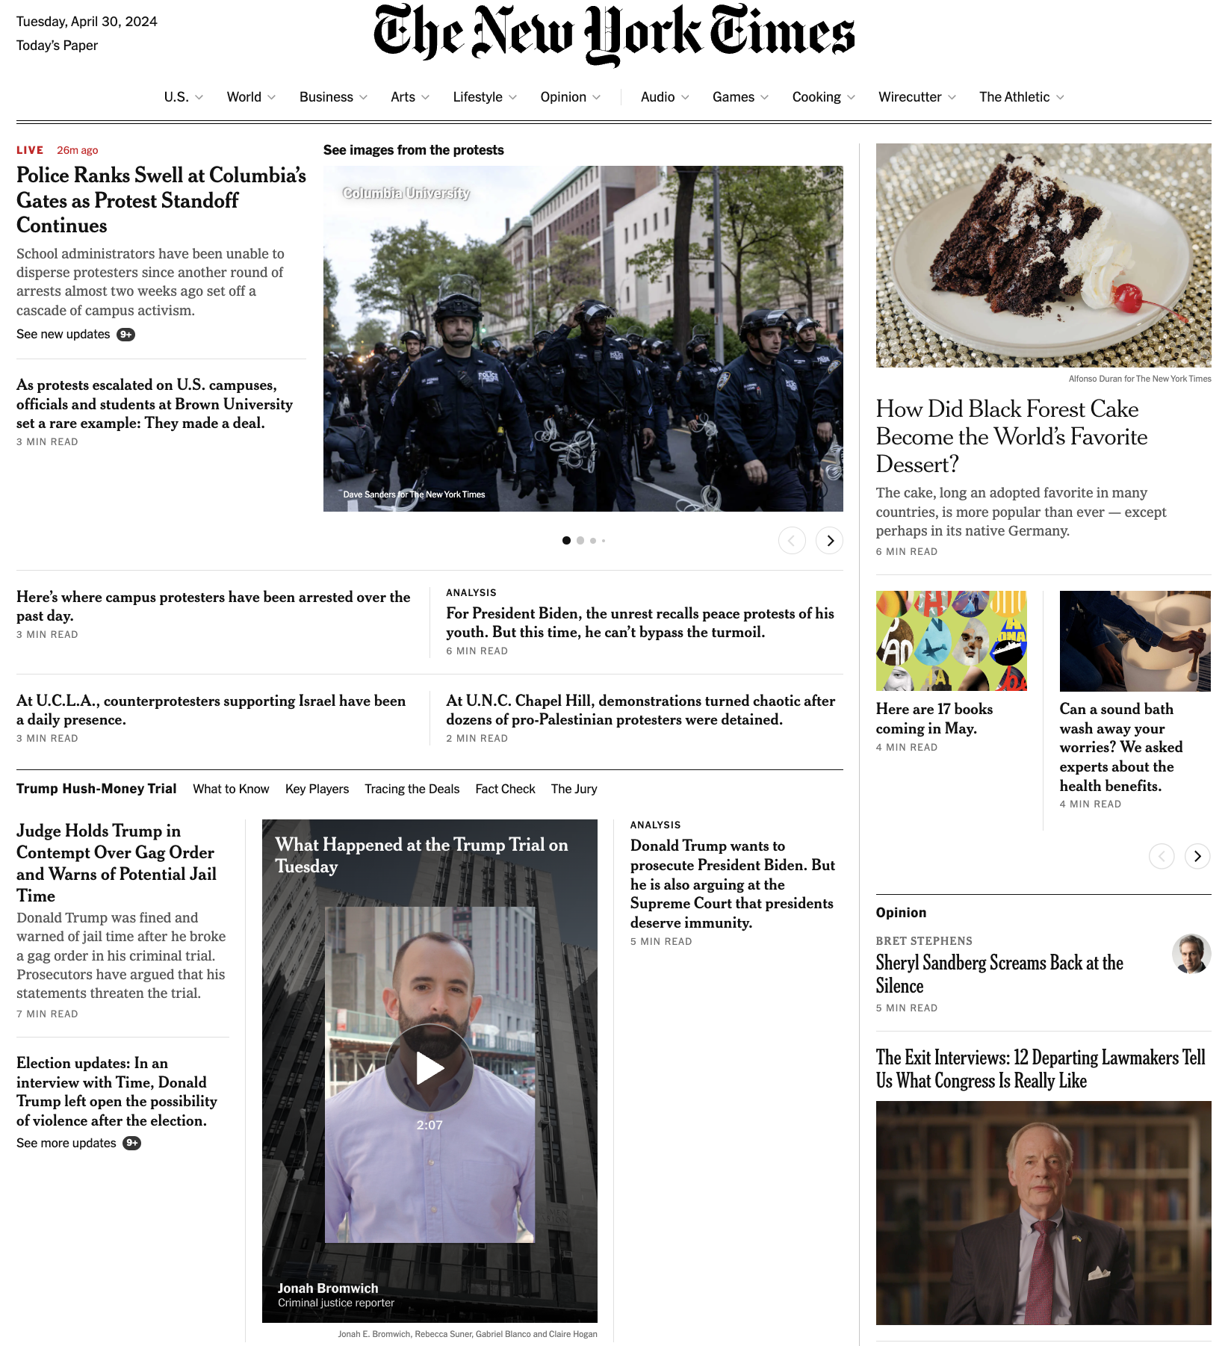
Verifiability is challenging
To trust LLMs, users need to verify generated claims against trusted resources
However, non-trivial to fact-check lengthy free-form generation!
🧐
User: which NYT article support this claim???
Notes:
- start with hallucination
- so user will need to verify the response against trusted responses
- how can user verify? (1) by themselves (2) citation
– we propose the quoting interface

Slide 4
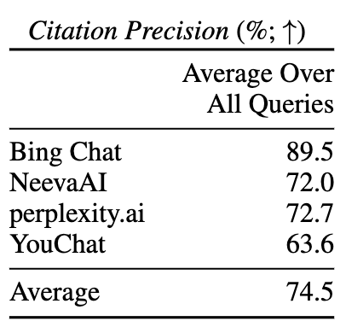
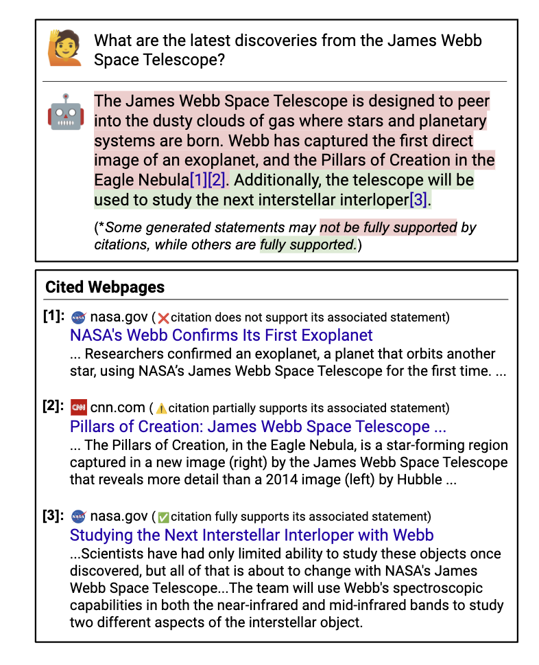
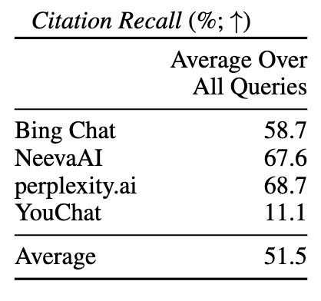
Existing methods for verifiability
Search/retrieval + citation helps, but is not guaranteed to be accurate
Non-trivial to verify whether text is supported by citation
Nelson Liu, Tianyi Zhang, and Percy Liang. 2023. Evaluating Verifiability in Generative Search Engines. In Findings of the Association for Computational Linguistics: EMNLP 2023
Notes:
Existing methods on citations helps with verifiability but provide not guarantees
Even if a piece of text contains a citation, it’s non-trivial to check whether the cited evidence actually support the text

Slide 5



Verifiability by Quoting
We propose increasing verifiability by generating verbatim quotes from high-quality sources of pre-training data, such as Wikipedia.
LLM that can quote
generate
Response with quotes: Jeopardy! was created by Merv Griffin and first aired in 1964, while Wheel of Fortune was also created by Merv Griffin and first aired in 1975. Therefore, Jeopardy! is older than Wheel of Fortune.
“ ”
verify quotes
High-quality subset of pre-training corpus
Notes:
We propose increasing verifiability by generating verbatim quotes from high-quality sources in pre-training data
First, an LLM capable of quoting generates responses as usual
Then, we use the high-quality subset of pre-training corpus to verify quoted spans of generated text post-hoc

Slide 6
Verifiability by Quoting
We propose increasing verifiability by generating verbatim quotes from high-quality sources of pre-training data, such as Wikipedia.
Quote-Tuning: aligning LLMs to quote from their pre-training data!
Make the model prefer generation with more quotes over less quotes!
Align for quoting using preference optimization algorithms such as DPO
Base LLM
LLM that can quote
align for quoting
generate
Response with quotes: Jeopardy! was created by Merv Griffin and first aired in 1964, while Wheel of Fortune was also created by Merv Griffin and first aired in 1975. Therefore, Jeopardy! is older than Wheel of Fortune.
“ ”
verify quotes
High-quality subset of pre-training corpus
Notes:
- We propose quote-tuning, which aligns LLMs to quote through data curation and preference optimization

Slide 7

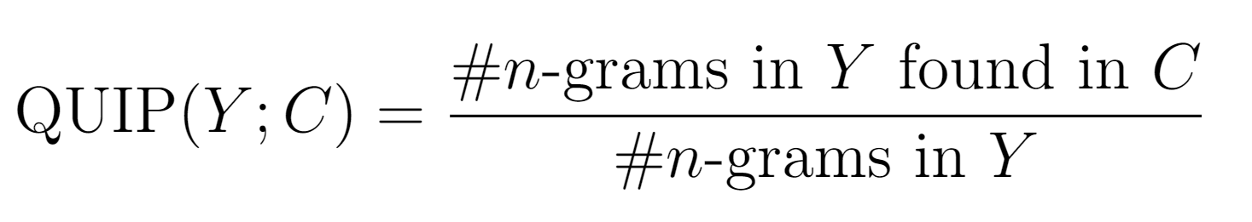
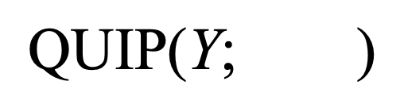
Background: measuring quoting at scale
generated text
A large corpus
$$\text{QUIP}\text{(}\text{Y}\text{; } \text{)}$$
Calculate quoting precision with QUIP-Score (Weller et al., 2024)
QUIP-Score is backed by efficient membership testing with Data Portraits (Marone and Van Durme, 2023)
Bloom filter data sketching on large corpora
Notes:
To measure quoting at scale, we use QUIP Score
It is the percentage of n-grams in the generated text found in a large corpus
We use Data Portraits, a Bloom filter based data sketch, for efficient membership testing

Slide 8
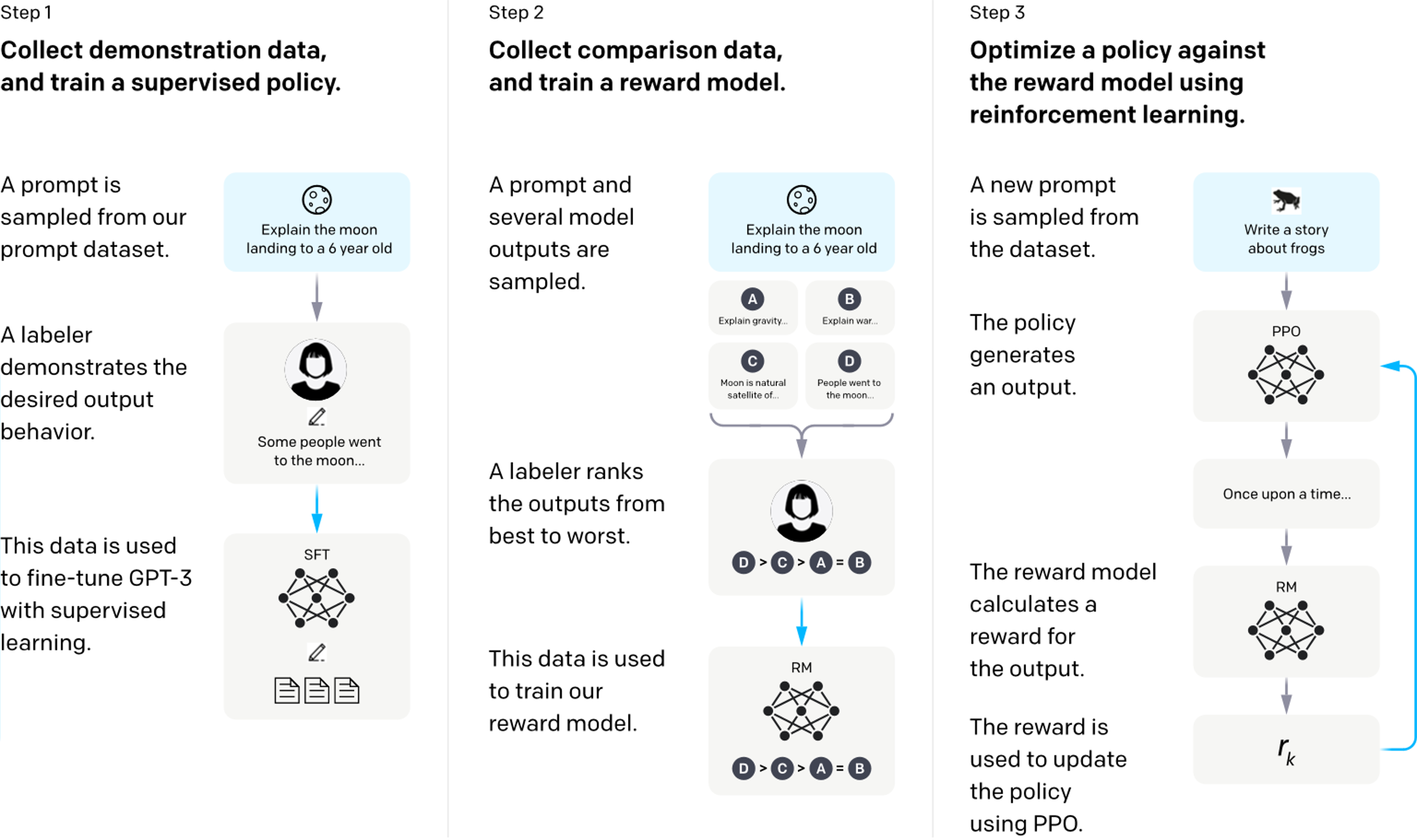
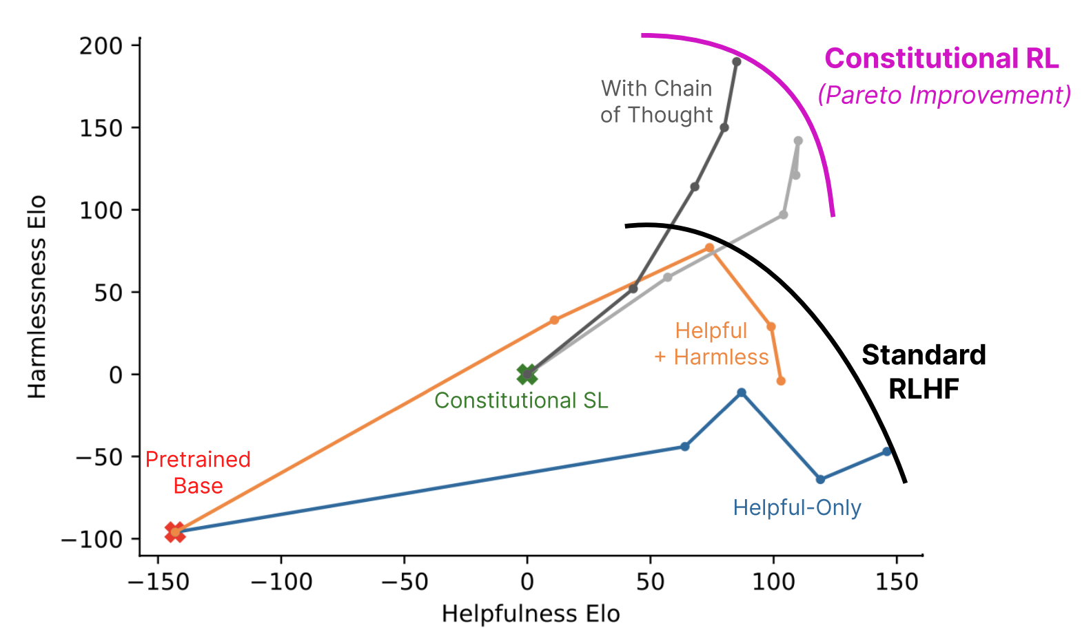
Background: preference optimization
Reinforcement Learning from Human Feedback (RLHF) aligns language models to…
(Ouyang et al., 2022)
(Bai et al., 2022)
Follow instructions (+helpfulness)
Reduce harmful outputs
Notes:
RLHF has been used to align models to be…
More helpful (better instruction following)
And safer (reduce harmful outputs)

Slide 9
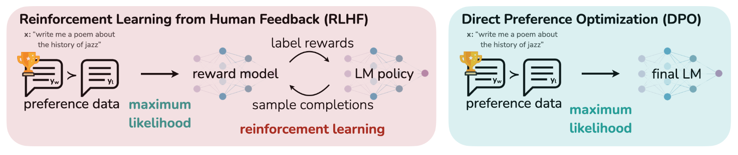
Background: preference optimization
Direct Preference Optimization (Rafailov et al., 2023) simplifies the RLHF pipeline, optimizing a dataset of preference without RL
Notes:
Basically, DPO need a set of paired preference data, where y_win is more preferred than y_lose

Slide 10
Our method: Quote-Tuning
Pre-trained LLM
Quote-tuned LLM
Prompt Dataset
Step 3: Preference Optimization
Prompt: Which is older jeopardy or wheel of fortune?
High-quality subset of pre-training corpus
“ ”
Preference Dataset for Quoting
Step 1: Sample
multiple responses
Prompt: Which is older jeopardy or wheel of fortune?
Chosen Response: Jeopardy! was created by Merv Griffin and first aired in 1964, while Wheel of Fortune was also created by Merv Griffin and first aired in 1975. Therefore, Jeopardy! is older than Wheel of Fortune.
Rejected Response: Jeopardy! was created in 1964 by Merv Griffin, while Wheel of Fortune was created in 1975 by Merv Griffin and Roy Leonard. Therefore, Jeopardy! is older than Wheel of Fortune.
Measure quoting via efficient membership testing
Raw LLM Responses
Response: Jeopardy! was created by Merv Griffin and first aired in 1964, while Wheel of Fortune was also created by Merv Griffin and first aired in 1975. Therefore, Jeopardy! is older than Wheel of Fortune.
🥇🥈🥉
✅ QUIP: 31.4, length: 66
Step 2: Constructing preference data via rank-by-quoting
≈
❌ QUIP: 1.99, length: 60
Notes:
This is the overview of our approach
We will walkthough individual parts in more details

Slide 11
Step 1: Sample candidate responses
Prompt Dataset
Prompt: Which is older jeopardy or wheel of fortune?
High-quality subset of pre-training corpus
Step 1: Sample
multiple responses
Raw LLM Responses
Response: Jeopardy! was created by Merv Griffin and first aired in 1964, while Wheel of Fortune was also created by Merv Griffin and first aired in 1975. Therefore, Jeopardy! is older than Wheel of Fortune.
Step 1. Generate completions from an LLM (e.g. using QA pairs or text completions)

Slide 12
Step 2: Synthesize Dataset by Filtering
Prompt Dataset
High-quality subset of pre-training corpus
Prompt: Which is older jeopardy or wheel of fortune?
Preference Dataset for Quoting
Step 1: Sample
multiple responses
Prompt: Which is older jeopardy or wheel of fortune?
Chosen Response: Jeopardy! was created by Merv Griffin and first aired in 1964, while Wheel of Fortune was also created by Merv Griffin and first aired in 1975. Therefore, Jeopardy! is older than Wheel of Fortune.
Rejected Response: Jeopardy! was created in 1964 by Merv Griffin, while Wheel of Fortune was created in 1975 by Merv Griffin and Roy Leonard. Therefore, Jeopardy! is older than Wheel of Fortune.
Measure quoting via efficient membership testing
Raw LLM Responses
Response: Jeopardy! was created by Merv Griffin and first aired in 1964, while Wheel of Fortune was also created by Merv Griffin and first aired in 1975. Therefore, Jeopardy! is older than Wheel of Fortune.
🥇🥈🥉
✅ QUIP: 31.4, length: 66
Step 2: Constructing preference data via rank-by-quoting
≈
❌ QUIP: 1.99, length: 60
Step 2. We can construct a preference dataset by ranking generations by the amount of quoting
(QUIP-Score; Weller et al., EACL 2024)

Slide 13
Step 3: Making the model prefer more quoting!
Pre-trained LLM
Quote-tuned LLM
Prompt Dataset
Step 3: Preference Optimization
Prompt: Which is older jeopardy or wheel of fortune?
High-quality subset of pre-training corpus
“ ”
Preference Dataset for Quoting
Step 1: Sample
multiple responses
Prompt: Which is older jeopardy or wheel of fortune?
Chosen Response: Jeopardy! was created by Merv Griffin and first aired in 1964, while Wheel of Fortune was also created by Merv Griffin and first aired in 1975. Therefore, Jeopardy! is older than Wheel of Fortune.
Rejected Response: Jeopardy! was created in 1964 by Merv Griffin, while Wheel of Fortune was created in 1975 by Merv Griffin and Roy Leonard. Therefore, Jeopardy! is older than Wheel of Fortune.
Measure quoting via efficient membership testing
Raw LLM Responses
Response: Jeopardy! was created by Merv Griffin and first aired in 1964, while Wheel of Fortune was also created by Merv Griffin and first aired in 1975. Therefore, Jeopardy! is older than Wheel of Fortune.
🥇🥈🥉
✅ QUIP: 31.4, length: 66
Step 2: Constructing preference data via rank-by-quoting
≈
❌ QUIP: 1.99, length: 60
Step 3. Tune a model to prefer more quotes with direct preference optimization (DPO)!

Slide 14
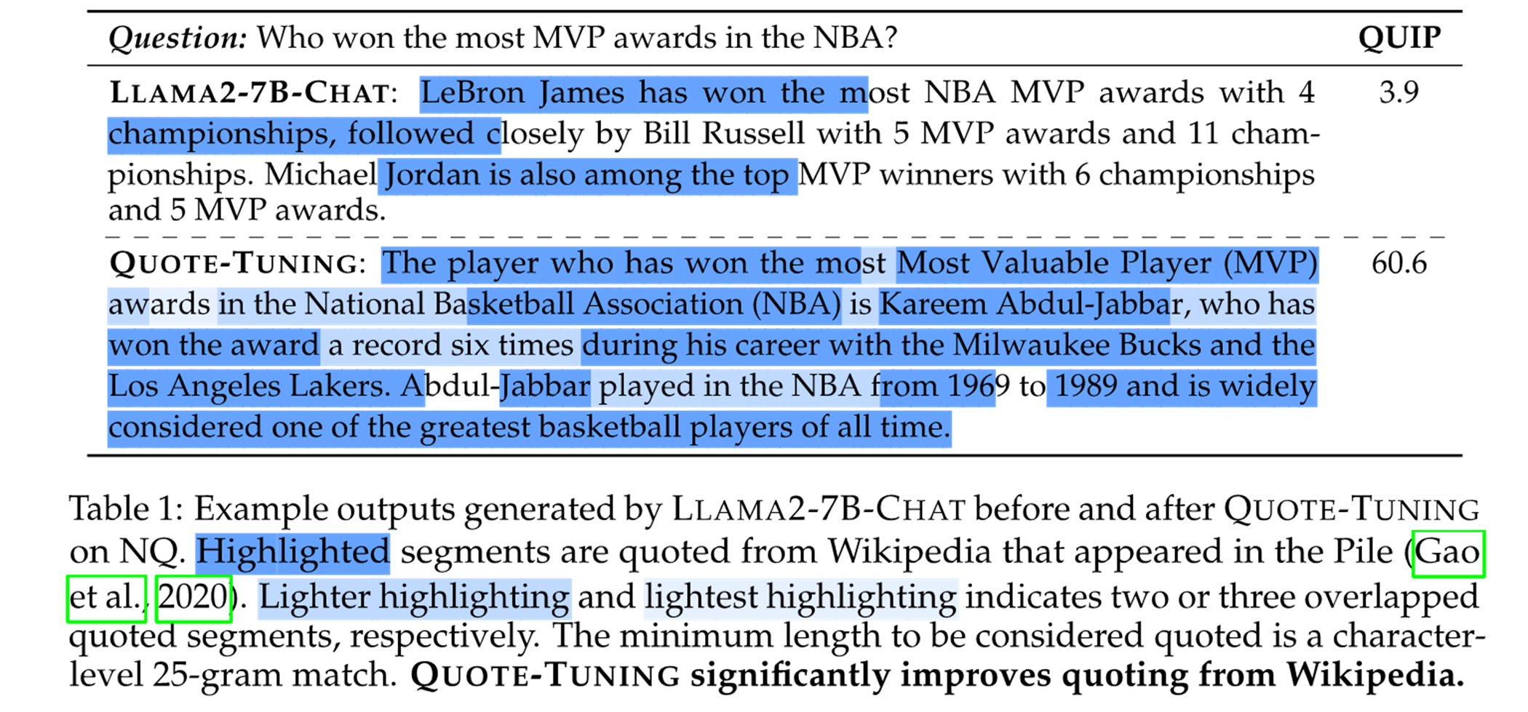
Quote-Tuning significantly increases amount of quoting
sparse quotes
generation is densely quoted!
Notes:
- Original model only have sparse, short quotes
– After quote-tuning, generation is densely quoted, greatly enhancing verifiability

Slide 15
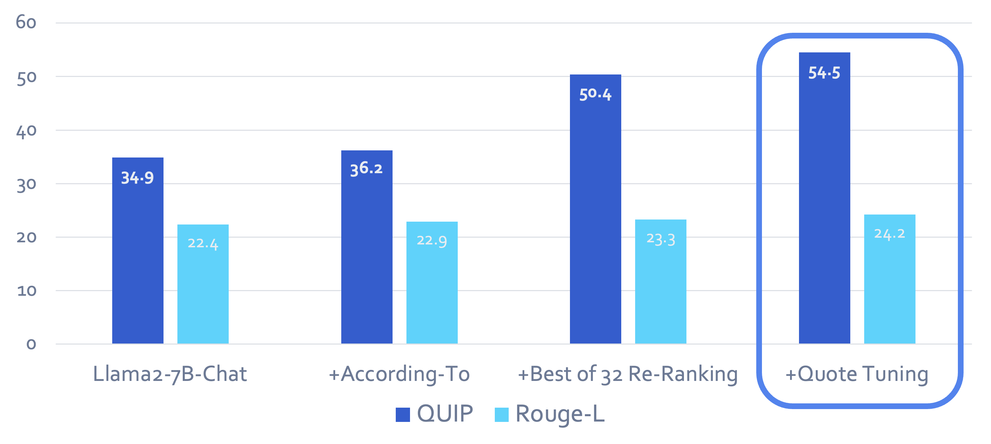
Same Quality, More Quoting!
You can obtain models that provide more quoted responses,
without losing accuracy.
Notes:
Best of 32 reranking is a strong baseline
We beat Best of 32 reranking in terms of QUIP score while maintaining quality!

Slide 16
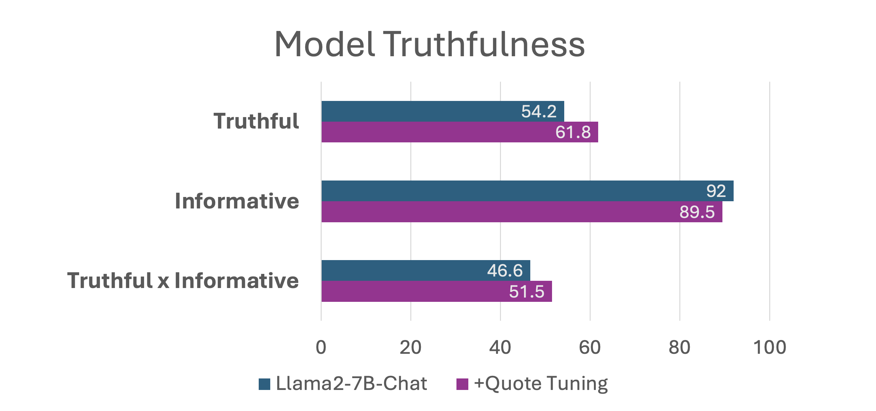
Quote-Tuning improves truthfulness
Dataset: TruthfulQA (Lin et al., 2021)

Slide 17
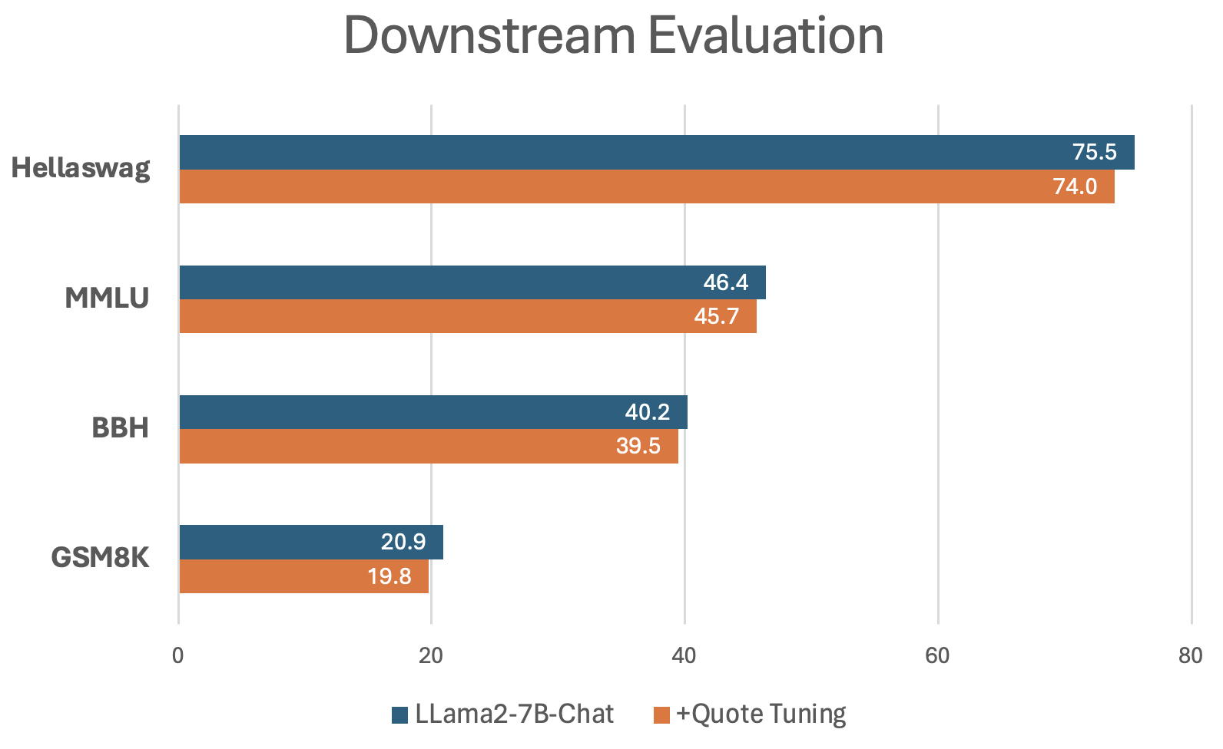
Downstream Evaluation
Quote-Tuning significantly improves quoting with only a minor sacrifice on general performance (<2 points across the board).

Slide 18
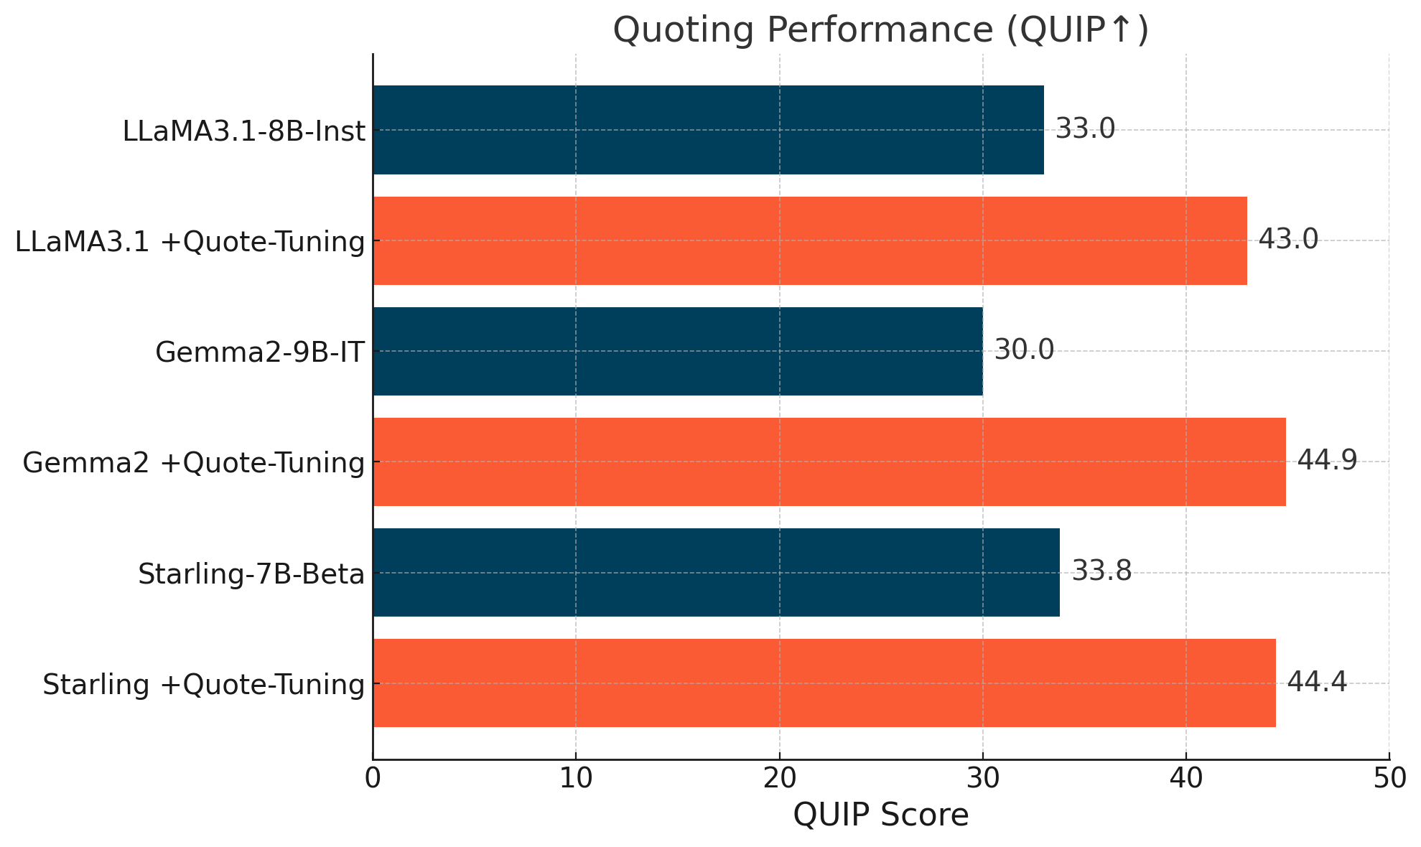
Quote-Tuning is effective across model families

Slide 19
Summary and Future Directions
LLMs can be aligned to quote from known sources observed in their pre-training data
Quoting makes the verifiability question trivial
Open questions and future directions:
How do we incentivize quoting when it matters?
How to ensure long, contiguous quotes?
How to generalize to reasoning problems, and more general settings?
…

Slide 20

Thanks for listening!
Questions?
<-link to preprint

Slide 21
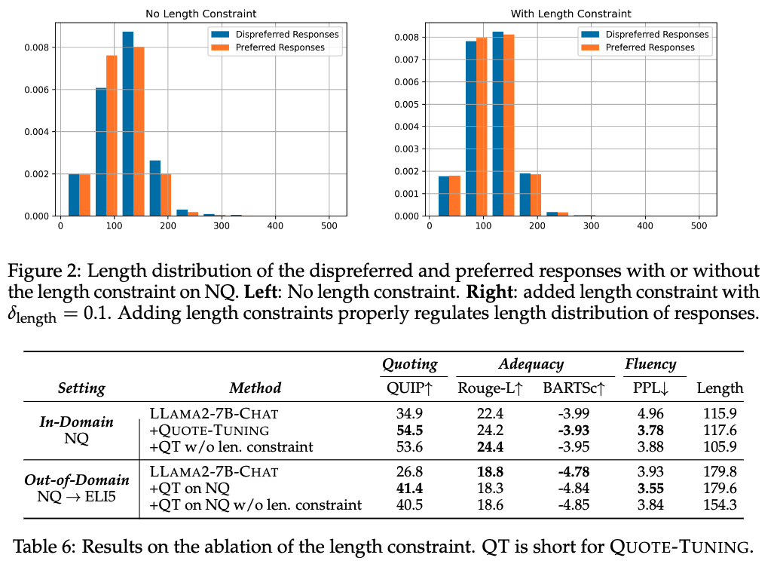
Ablation on length constraint
Without length constraints, the avg output length becomes notably shorter
We hypothesize this is due to bias in synthetic preference data (around length 100 has the highest gap of preferred > disprefered)
Length constraint is effective at regularizing length and lead to slightly better quoting

Slide 22
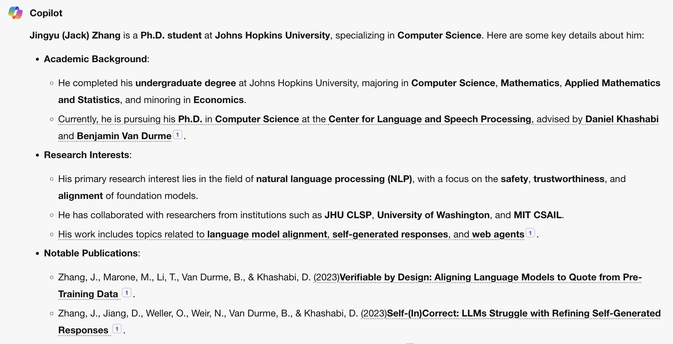
LLMs have a verifiability challenge
Known to produce seemingly plausible but erroneous outputs, aka hallucination
Hard to verify their factual correctness!

Slide 23
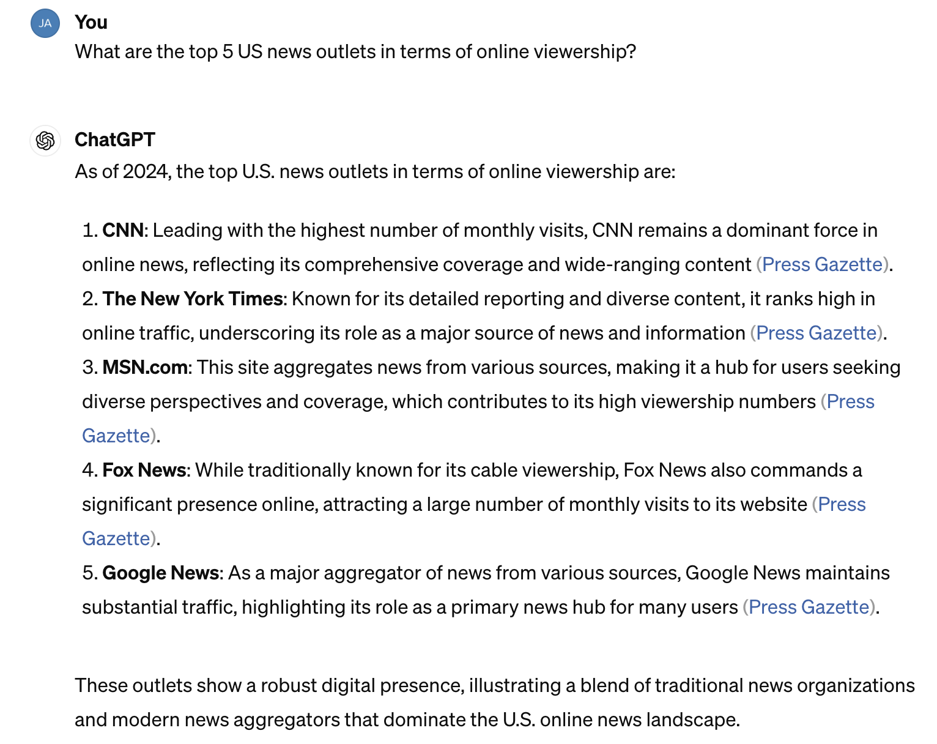
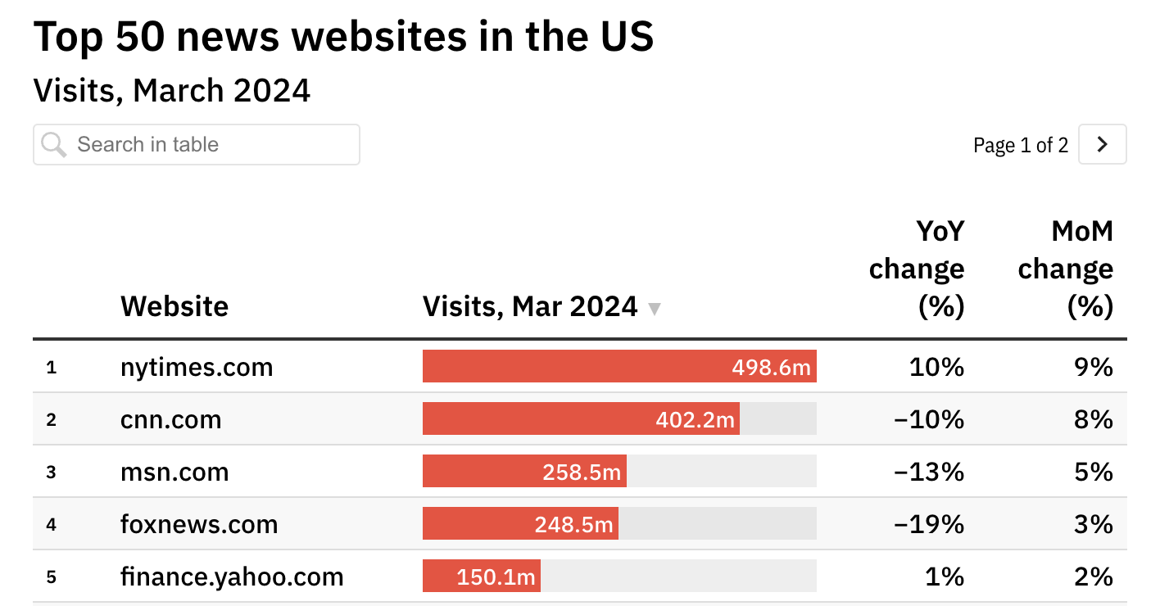
LLMs have a verifiability challenge

Slide 24
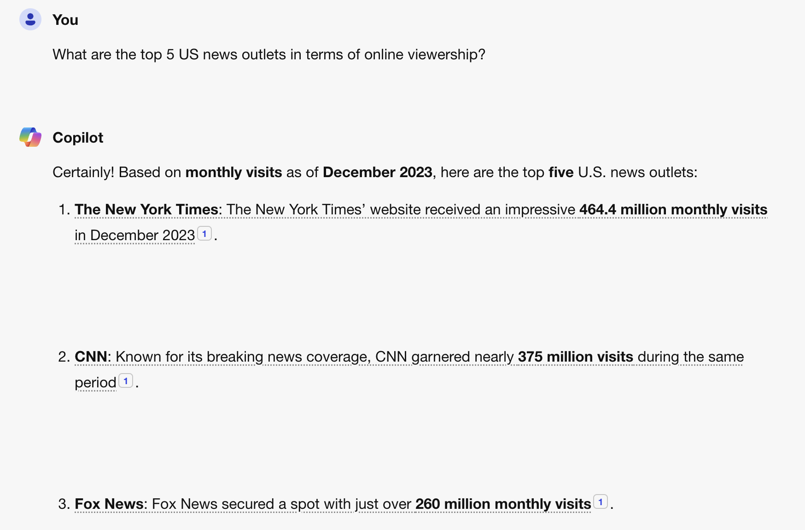
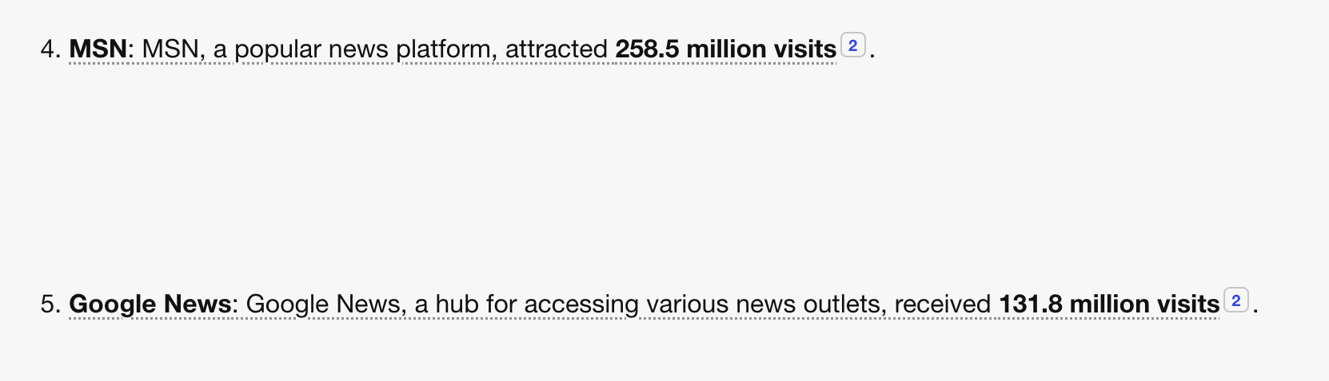

Slide 25
Users need verifiable outputs!
Known to produce seemingly plausible but erroneous outputs, aka hallucination
Hard to verify the factual correctness of generated claims!
???
Notes:
- start with hallucination
- so user will need to verify the response against trusted responses
- how can user verify? (1) by themselves (2) citation
– we propose the quoting interface
- Emphasize the quoting is from **pre-training**
- give a high-level overview of method before diving in details

Slide 26
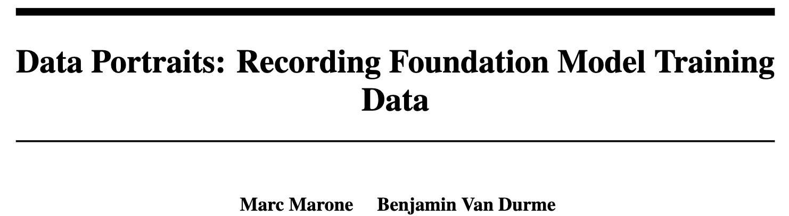
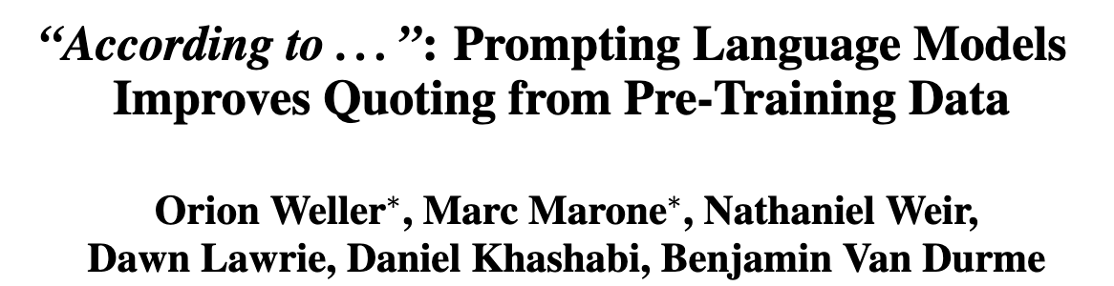
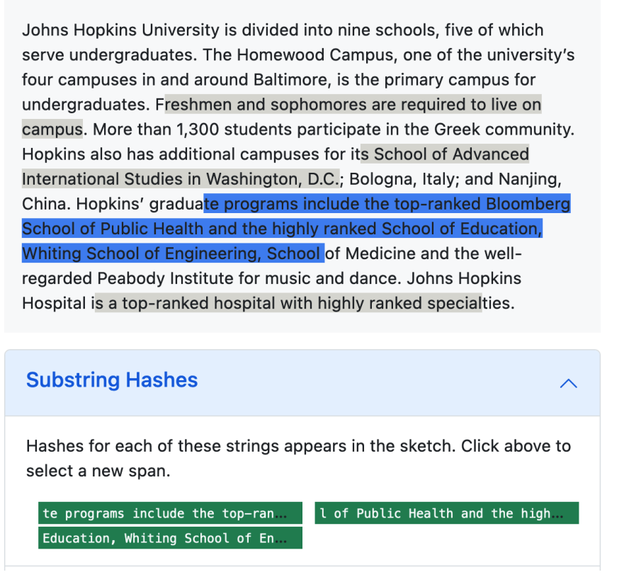
Background: measuring quoting at scale
Calculate quoting precision with QUIP-Score (Weller et al., 2024)
Efficient membership testing with Data Portraits (Marone and Van Durme, 2023)

Slide 27
Step 1: Sample candidate responses
Prompt Dataset
High-quality subset of pre-training corpus
Prompt: Which is older jeopardy or wheel of fortune?
Step 1: Sample
multiple responses
Raw LLM Responses
Response: Jeopardy! was created by Merv Griffin and first aired in 1964, while Wheel of Fortune was also created by Merv Griffin and first aired in 1975. Therefore, Jeopardy! is older than Wheel of Fortune.
Measure quoting via efficient membership testing
Membership testing tools (Marone & Van Durme, NeurIPS 2023) let us efficiently determine how much of a generation is quoted

Slide 28
(Tianjian: This slide can be skipped)
Prompt Dataset
High-quality subset of pre-training corpus
Prompt: Which is older jeopardy or wheel of fortune?
Preference Dataset for Quoting
Step 1: Sample
multiple responses
Prompt: Which is older jeopardy or wheel of fortune?
Chosen Response: Jeopardy! was created by Merv Griffin and first aired in 1964, while Wheel of Fortune was also created by Merv Griffin and first aired in 1975. Therefore, Jeopardy! is older than Wheel of Fortune.
Rejected Response: Jeopardy! was created in 1964 by Merv Griffin, while Wheel of Fortune was created in 1975 by Merv Griffin and Roy Leonard. Therefore, Jeopardy! is older than Wheel of Fortune.
Measure quoting via efficient membership testing
Raw LLM Responses
Response: Jeopardy! was created by Merv Griffin and first aired in 1964, while Wheel of Fortune was also created by Merv Griffin and first aired in 1975. Therefore, Jeopardy! is older than Wheel of Fortune.
🥇🥈🥉
Step 2: Constructing preference data via rank-by-quoting

